Slide 1
Do Colleges Gentrify Boston
Group 6: Nate Kirschner, Sebastian Kobori,
Sarah Lang, Caleb Lee
Notes:
Summary of work and why important
-How it is relevant to Boston
Why we chose our datasets?
How we grouped and managed data?
-Missing data

Slide 2
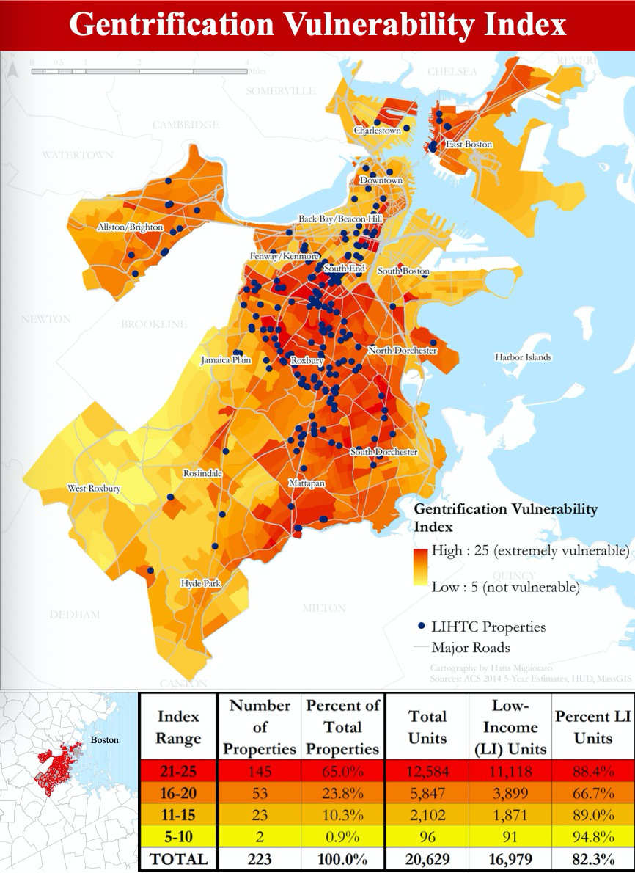
Background
Gentrification
Common yet controversial topic
a process where wealthy people move into an area, raising rent and housing prices and pushing out the original residents
displace low-income families or, more often, prevent low-income families from moving into previously affordable neighborhoods
https://sites.tufts.edu/gis/files/2016/01/Migliorato_Hana_UEP232_2016.pdf
Notes:
Boston specific history or context
Graphic

Slide 3
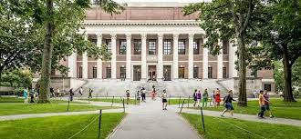
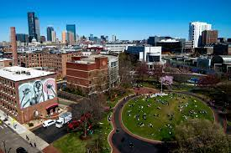
How our research relates to Boston
Boston is a “collegetown”, with 27 colleges & 50,000 students in the city of Boston
Boston is a city with severe gentrification (Smith)
ranked 3rd most in the nation
21.3% of the city is gentrified from 2013-2017
Assumption : Students may move to a neighborhood to attend a college in an adjacent neighborhood, thus raising the living standard of that area. The more college students, the higher prices.
https://www.topuniversities.com/where-to-study/north-america/united-states/top-universities-boston
https://news.northeastern.edu/2020/03/11/in-light-of-the-covid-19-outbreak-northeastern-university-moves-to-online-learning-at-its-boston-campus/

Slide 4
Research Questions
All in tracks, not neighborhood
Stage 1:
Does the presence of a university affect the growth in median housing rent in the tract? (rent change)
Stage 2:
Does the net price (expected cost for ) of all universities affect the change in median gross rent in the tract?

Slide 5
Necessary Data
Inaccuracy: census cannot accurately analyze 40-year span
Solution: We reduced it to 5-year span
Median gross rent & total population : 2015 & 2019 census
Colleges & students
Problem : not enough info on student addresses
Where students live
Incorrect addresses
Solution : Excel : List of Colleges
College-centric analysis
List of colleges & Student population : instead of looking up “colleges in Boston” on google, we looked for an accurate list of colleges that are in the zip codes of Boston
Looked up the zip codes on CollegeNavigator and took colleges that are 0 miles from the zip codes
Notes:
The census is not able to provide us with an accurate representation for median gross rent for the past 40 years
College Data was quite limited. We could get a look at the Net Price, but only for recent numbers. Net price growth for colleges normally stay the same over years, so we do not have access to the yearly net price. This made it not possible for us to analyze how the net price changed over time.
We could not find data on students who lived on vs. off campus or breakdowns of where students lived.
We cannot ensure that students put down their current address (maybe they still have their parents’ address on file)

Slide 6
Data Sources
Zip codes of Boston: http://www.ciclt.net/sn/clt/capitolimpact/gw_ziplist.aspx?CityKey=2507000&stfips=25&state=ma&stname=Massachusett
College Navigator : get the colleges in the zip codes (notes: colleges have to be 0 miles away from the zip code to be in the zip code): https://nces.ed.gov/collegenavigator
Put all college informations of colleges in Boston in an Excel spreadsheet
To get the tract (CT-ID) information about those colleges in order to map them: https://geomap.ffiec.gov/FFIECGeocMap/GeocodeMap1.aspx
Accessing 2015 and 2019 American Community Survey 5: https://towardsdatascience.com/accessing-census-data-with-python-3e2f2b56e20d
Shapes/outlines of tracts in Boston for mapping : https://data.boston.gov/dataset/census-2010-tracts1

Slide 7
How we used the data sources
Gathered a correct list of schools in the city of Boston (excluding schools in surrounding areas outside of the city)
Collected each school’s average net price after aid
Collected population of each CT-ID tract
Located each school in its corresponding CT-ID
Collected population of students in a specific neighborhood (while aware that students don’t all live in the area their schools are located)

Slide 8
Generating Data in Pandas
Goals:
merge census data from 2015 and 2019 to get the change in median gross rent over those years
Merge the combined 2015-19 data with colleges data to see how colleges (and students) affect the change in gross rent
Each row represents data for a unique CT-ID (a tract)
Tools:
**!pip install censusdata**
Pulled from American Community Survey (ACS)
Limitations:
a 5 year estimation (the time frame for our project) is strictly 2015-19 for the ACS, so we needed to compare data from those specific years
The ACS data from Python was grouped into blocks, which are subgroups of tract; we needed to aggregate those subgroups into CT-IDs

Slide 9
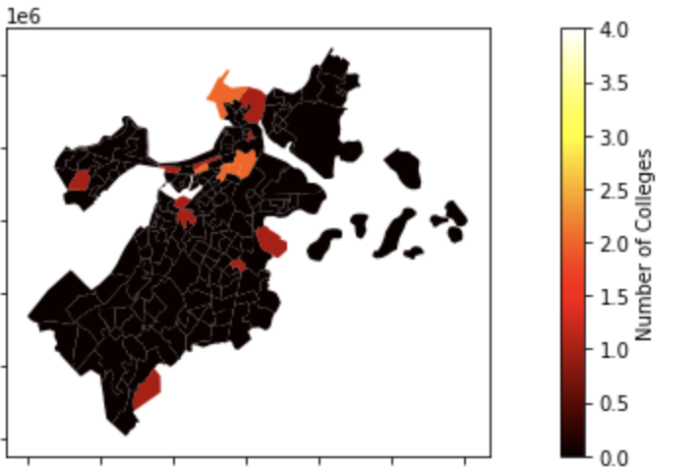
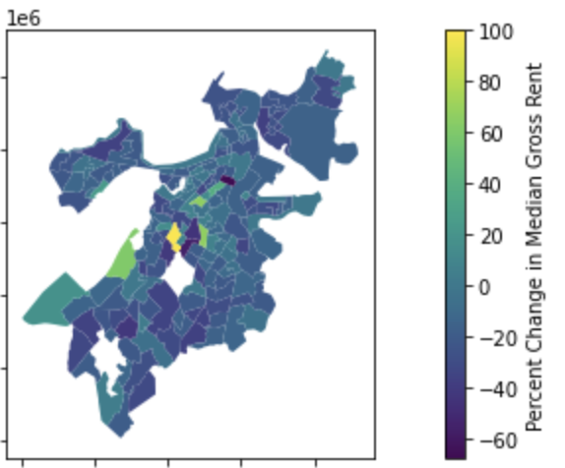
Map of Colleges in Boston
Number of Universities in each track
Map of Median Gross Rent In Boston
Ratio for median gross rent growth:
(2019 MGR - 2015 MGR) / 2015 MGR
Notes:
Locations of Colleges
Change in Med Gross Rent In locations with colleges
Change In Med Gross Rent (add map points of schools if we have time)

Slide 10
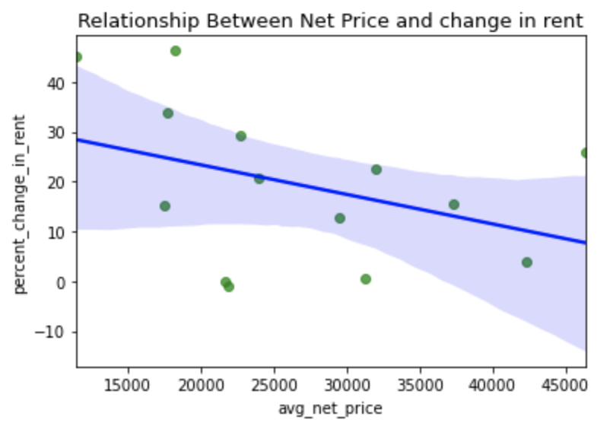

Slide 11
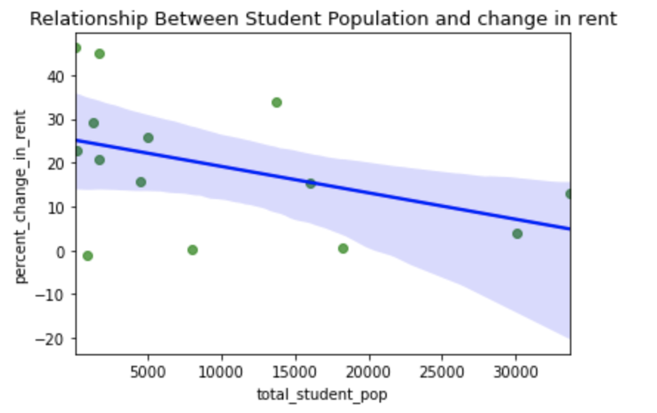

Slide 12
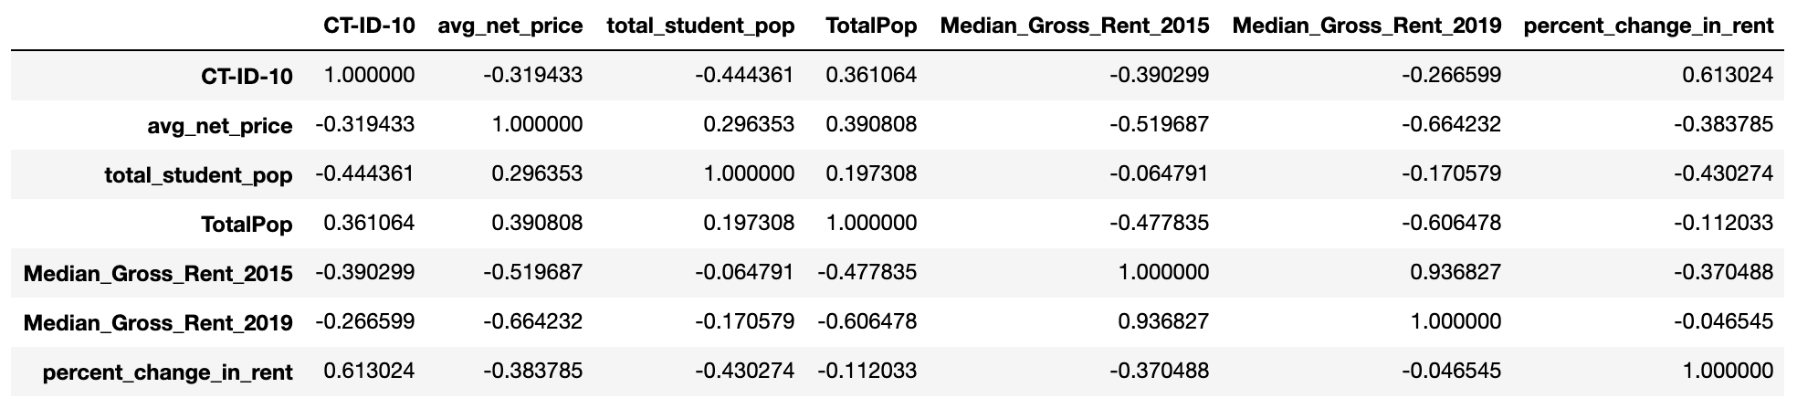

Slide 13
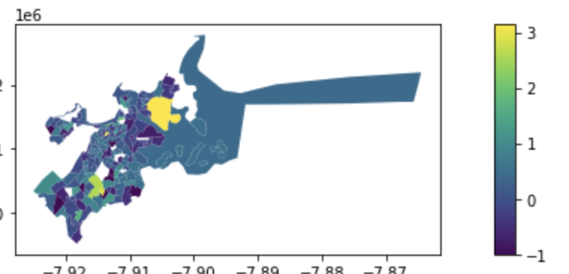
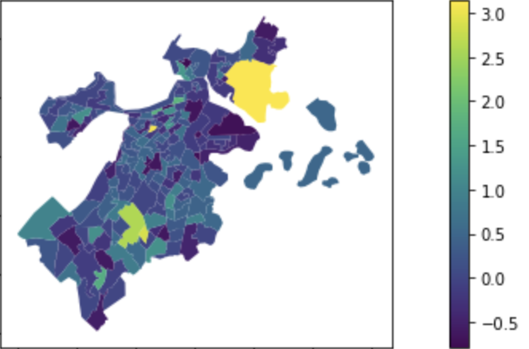
Problems while analyzing data
Shape files included huge tracts filled with water with no people, we needed to manually filter it out in the census’ med gross rent data,
Original Map
Correct Map
Notes:
Get screenshots of our issues

Slide 14
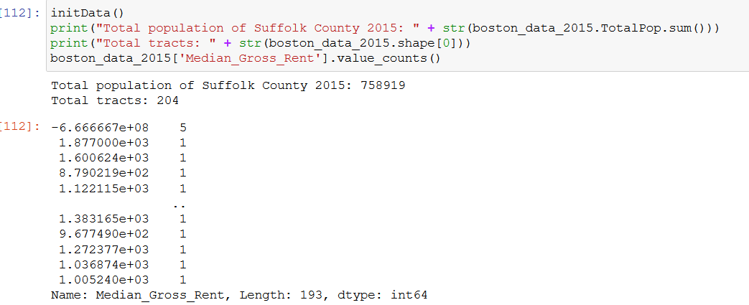
Yikes! Negative Rent is not a thing

Slide 15
Interpreting the result
Gentrification is a very complicated issue and cannot be determined by one single factor or another, therefore our interpretation of the data is merely a very simplified analysis of the cause of gentrification, and does not account for the full scope of how/why gentrification takes place.
Student population we collected from CollegeNavigator is not an accurate representation of how many students live in the area they attended school
On-campus vs off-campus breakdown
Very short time frame (only 5 years) and most colleges are already established for a long time that the students in recent years will not make a difference in the gentrification process

Slide 16
Questions?

Slide 17
Citation
Smith, D. (2020, July 09). In a new Study, Boston was ranked the THIRD-MOST Gentrified city
in the U.S. Retrieved February 04, 2021, from https://www.boston.com/news/local-news-2/2020/07/09/boston-ranked-third-most-gentrified-city#:~:text=The%20study%20shows%20that%2021.3,were%20gentrified%20between%202013%2D2017.&text=Boston%20has%20been%20ranked%20the,the%20National%20Community%20Reinvestment%20Coalition.
Photo Citation :
https://sites.tufts.edu/gis/files/2016/01/Migliorato_Hana_UEP232_2016.pdf
https://www.topuniversities.com/where-to-study/north-america/united-states/top-universities-boston
https://news.northeastern.edu/2020/03/11/in-light-of-the-covid-19-outbreak-northeastern-university-moves-to-online-learning-at-its-boston-campus/

